Slide 1



A Minor Project on
“Advanced Traffic Management Using
Image Processing”
Submitted by
Santosh Devkota (073/BEX/437)
Sarfraj Alam (073/BEX/438)
Sujan Gyawali (073/BEX/445)
Anil Sah Baniya (073/BEX/402)
Submitted to
Electronics and Computer Department

Slide 2
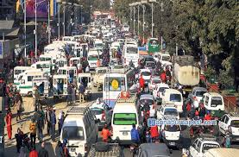
INTRODUCTION
A system that allows efficient traffic flow according to available road infrastructure.
Traffic problem
-A heavy topic for every nation

Slide 3
Problem Statement
With increasing urban population and hence the number of vehicles, need of controlling streets, highways and roads is major issue so we are proposing a system for advanced traffic control.

Slide 4
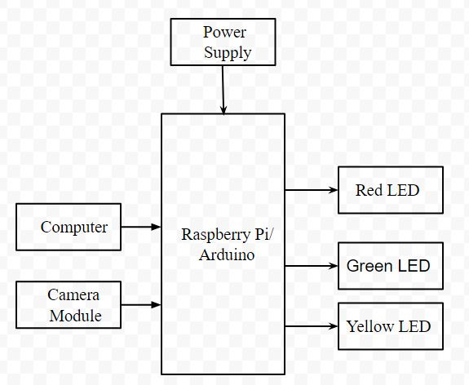
WORKING PRINCIPLE

Slide 5
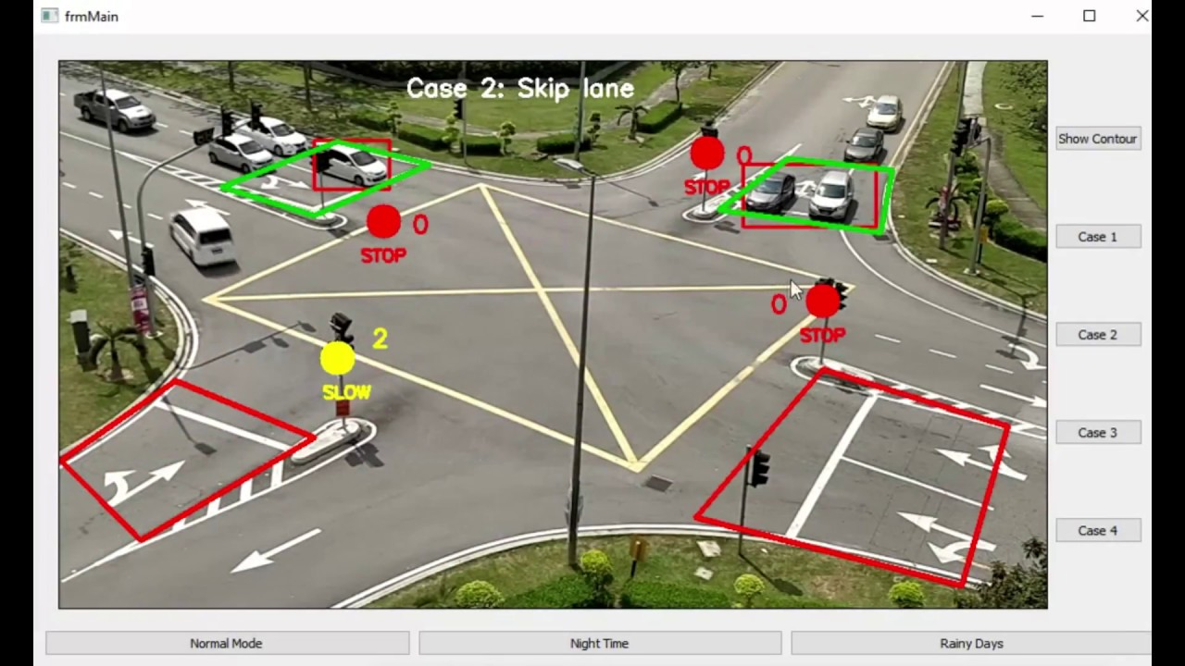
Procedures
Image processing
Traffic Density
Calculation
Decision making

Slide 6
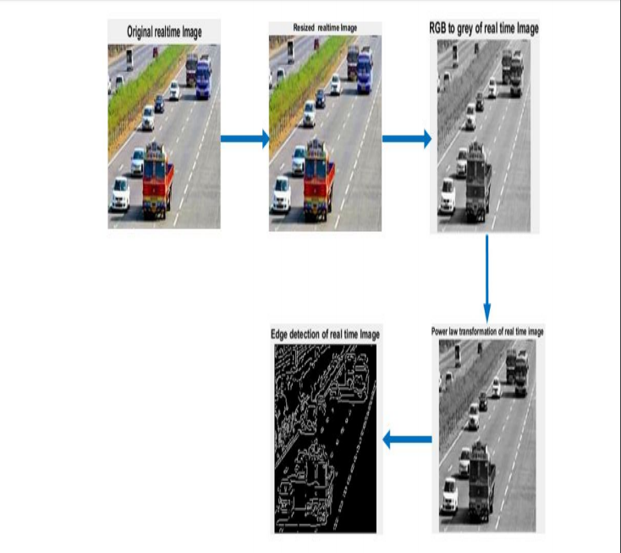

Slide 7
Why smart trafficking ?
Improved efficiency
Optimised fuel consumption
Compact size
Minimised time delay

Slide 8
System Requirements
Python IDE
Raspberry Pi
Camera Module (OV7670)
LED’s (as Traffic Signals)
Power Supply

Slide 9
What happens if the system is implemented?
Less burden in traffic management for traffic police
Decline in road accidents and fuel consumption
Minisation in traffic delay time
Boon to the places where road infrastructure is limited

Slide 10


